Slide 1

Our Mission
At Woodcot we believe good attendance is vital for a child to achieve their full potential.
We aim to promote good attendance by providing a safe and motivating environment for all children.
As a team, we will together break down any barriers a child or family may have to accessing their education.
Every child matters, every day matters.
Parental Home Agreement
Parents/ carers AND school both have a legal duty for attendance.
It is a legal requirement for each and every child to access regular education.
I need support with my child’s attendance
If you need support with your child’s attendance, please reach out to a member of the attendance team, or inform your child's class teacher.
FAQ’s
What is PA?
PA stands for ‘Persistently absent’. This is when your child’s attendance is below 90%
What is risk of PA?
Risk of PA is when your child’s attendance is at risk of dropping below 90%- we aim to offer early intervention support at this stage.
What is an FPN?
FPN stands for ‘Fixed Penalty Notice’ FPN’s are issued for unauthorised absences, this includes term time holidays.
I’ll just go on holiday and pay the fine?
FPN’s have now been capped nationally at TWO fines within any 3 year period. After this, other action like a parenting order or prosecution has to be considered - this could mean a fine of up to £2500!
What is an unauthorised absence?
A child being kept off school unnecessarily or without good reason. Term time holidays is not a justified reason to take your child out of school.
What happens if I keep my child off, and don’t contact school?
School will call home to try and obtain a reason for absence. Iff no reason is provided, school may carry out a visit to your home - this is to check on the welfare of you and your child.
School Attendance
Parent Guide
Attendance Team
Headteacher - Mrs M Beetlestone
Inclusion Leader (Attendance Lead) - Miss V McBryde
Family Support Coordinator - Mrs T Wood
Admin - Miss K Seaton
Telephone: 01329 234381
Email: admin@woodcotschool.co.uk
Please also refer to the full attendance policy that can be found on our website

Slide 2
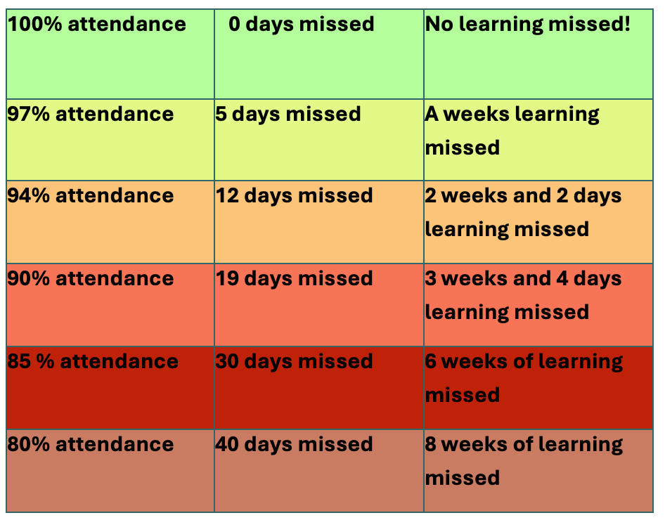
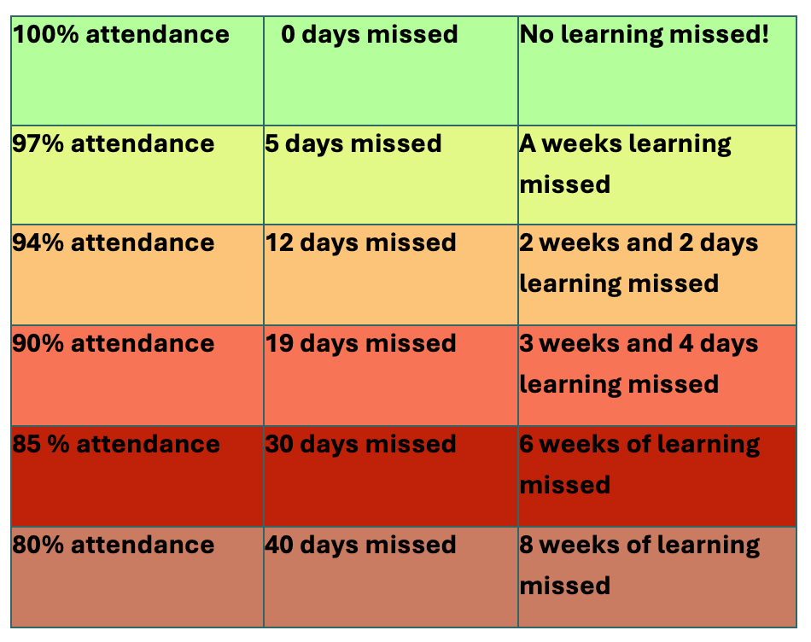
Every Day Counts
Every Minute Counts
‘90% attendance’ or ‘only 5 minutes late’ may sound like small issues, but the amount of learning missed is huge!
Attendance Procedures
Absence
If your child is going to be absent from school, you must contact the school office before 9.00 am to provide a reason for absence. You can either call 01329 234381 or email admin@woodcotschool.co.uk
Punctuality
If your child arrives to school after registration closes your child will receive an unauthorised late mark- this affects your child’s attendance.
You must accompany your child to sign in at the office when arriving late.
Fines - Holidays
Holidays are in no circumstances authorised by school.
Unauthorised absence due to holidays will result in a fine being issued from Hampshire County Council.
PA or Risk of PA
We want to avoid children becoming ‘persistently absent’ (below 90%).
Interventions will be put in place when your child's attendance becomes ‘at risk’ of becoming PA. This may include supportive parent meetings.
Being persistently absent may make you liable for fines or school attendance referrals.
Medical Evidence
If your child is absent from school and is at risk of becoming persistently absent (at risk of falling below 90%) you will be required to provide medical evidence for your child's absences.
This way, we can make sure absences are authorised.
Support and Advice
If you would like any support regarding your child’s attendance, please contact our Family Support Coordinator, Mrs Wood, via the school office.

